Slide 1

WNE UW
Topic: Risk , uncertainty, randomness
part a
Theory and experimenetal study
Notes:
1

Slide 2
Risk , uncertainty, randomness
According to Knight and Keynes (1921), we can distinguish two definitions of uncertainty.
risk refers to a situation that can be insured against and risk means we can define an array of outcomes with probabilities attached.
uncertainty to outcomes that cannot be insured against
But in economic textbooks, we do not find the distinguish.

Slide 3
Story of the risk and uncertainty
When we teach about risk and uncertainty, we talk a story that we are living in the TV series Let's Make a Deal.
You will know the series from Monty Hall problem but the explanation power of Let's Make a Deal is much wider. This TV series is the best allegory of expected utility theory.

Slide 4
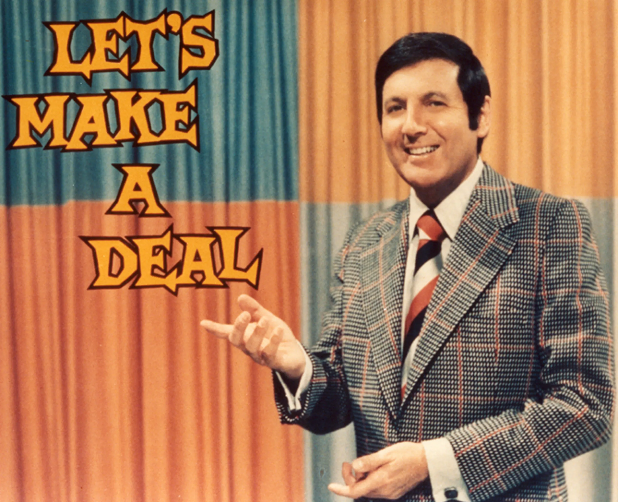
TV show Let’s Make a Deal the best allegory of expected utility theory
We have to choose between three doors –> we know the probabilities. We guess the values of hidden prizes: one small prize, one big prize and sometime we win nothing. Our knowledge is based on the previous episodes – Bayes inference. Sometimes the host offers us to give up the play and we can obtain sure compensation. The host is like a financial or insurance institution – he offers us a risk-free alternative.
$ 0
1/3
S
1
$ 900
G
1/3
$ 1000
1/3
$ 11 000
In more sophisticated financial models, the story is the same -> We know/ we can estimate the distribution of returns from historical data.

Slide 5
Risk , uncertainty, randomness
Using the model [like Let’s Make a Deal] we can evaluate the risk. The valuation depends on:
statistical properties of the lottery, which we are playing ( Expected Value, Variance, …)
our risk aversion, which can be measured
our initial endowment M0.
Condition: We should; know the probability theory and statistics to evaluate the risk

Slide 6
Logic and statistical thinking
You know the probability theory and statistics from your courses, don’t you? But the problem is the functional knowledge. It is hard to connect your knowledge with the everyday economic experience.
In general, we have some troubles with probability. Even simple rules of probability calculation are replaced by heuristics . Using the experiments results it is easy to prove it.

Slide 7
Linda
Linda is 31 years old, single, outspoken, and very bright. She majored in philosophy. As a student, she was deeply concerned with issues of discrimination and social justice, and also participated in anti-nuclear demonstrations.
Which is more probable?
A - Linda is a bank teller
B - Linda is a bank teller and is active in the feminist movement.

Slide 8
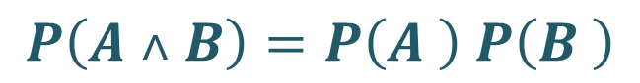
Linda
Example: The probability of two events occurring together (Conjunction of events) should be less than or equal to the probability of either one occurring alone.
$P\left(A ˄ B\right)≤P\left(A \right) and P\left(A ˄ B\right)$ $≤P\left(B \right)$
If the events A and B are independent
$$P\left(A ˄ B\right)=P\left(A \right) P\left(B \right)$$

Slide 9
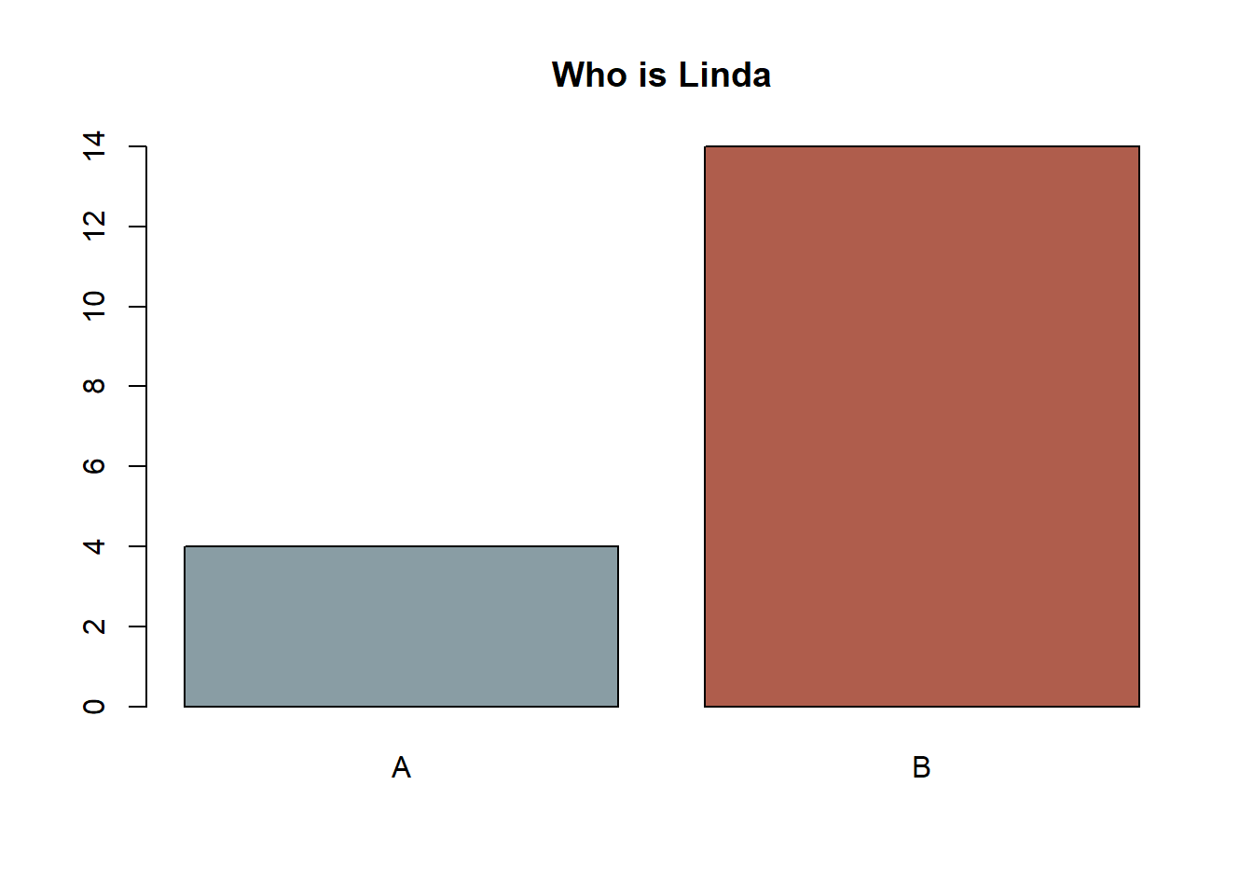
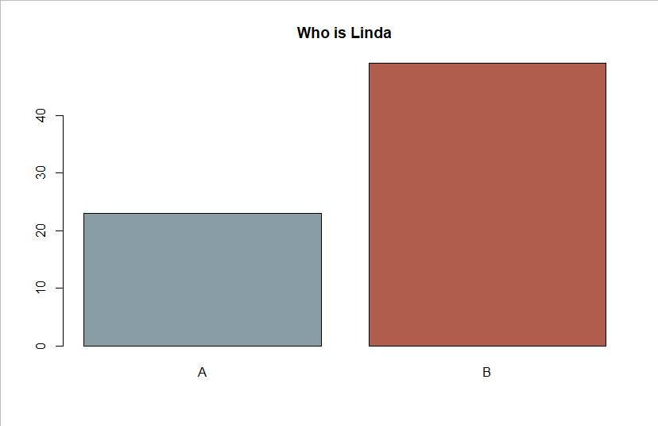
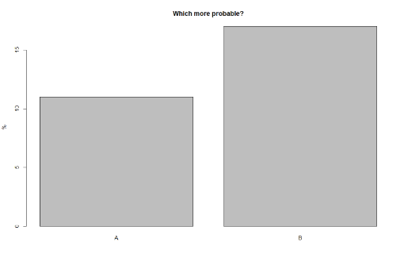
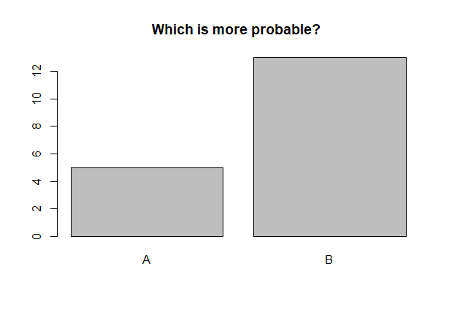
Did you get caught in the Linda trap?
Yes, you did.
The trap is working fine.

Slide 10
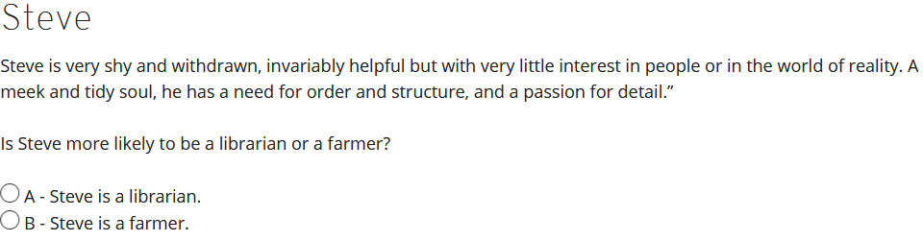
Problem with the perception of the probability Did you get caught in the Steve trap?
The typical judgment is based on the stereotypes of a librarian and farmer and the judgment ignores a relevant fact: there are many more farmers than librarians (more than twenty times). We should base our inference on proportion of farmers to librarians not who fit more into the stereotype.

Slide 11
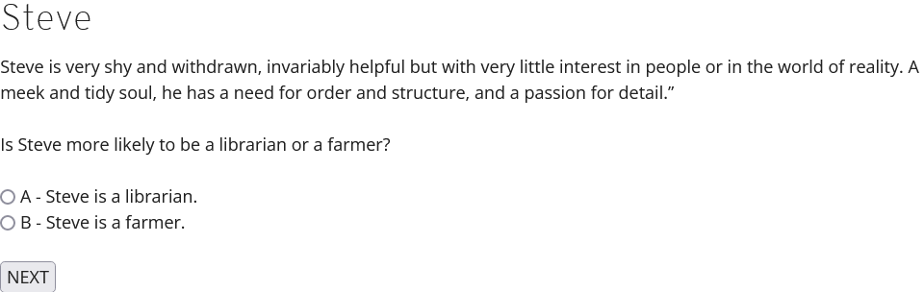
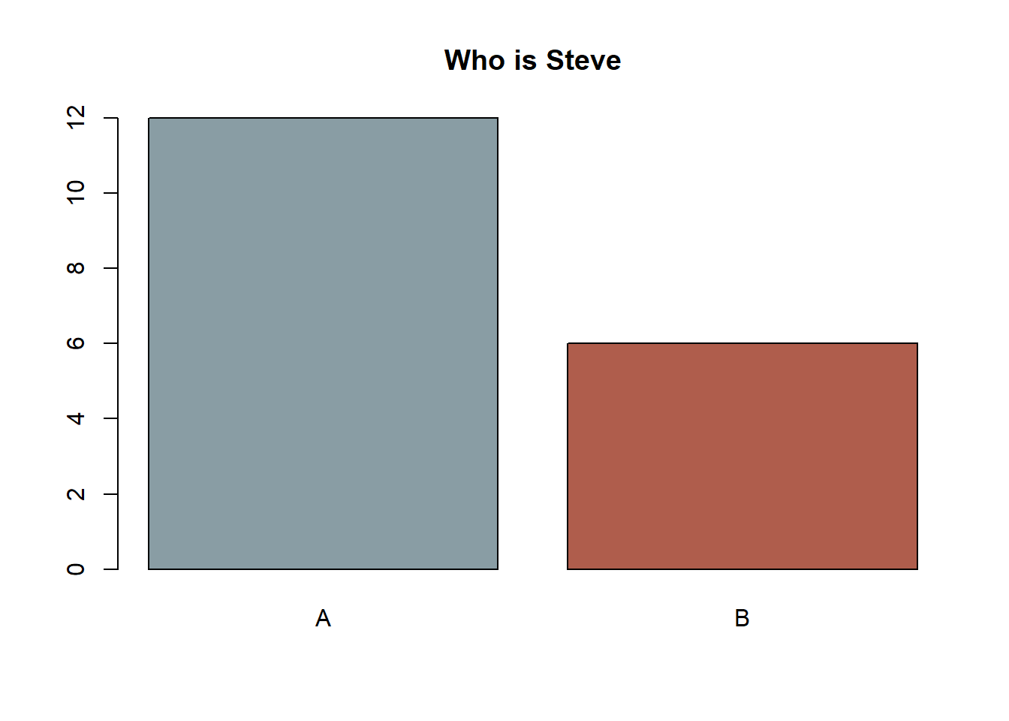
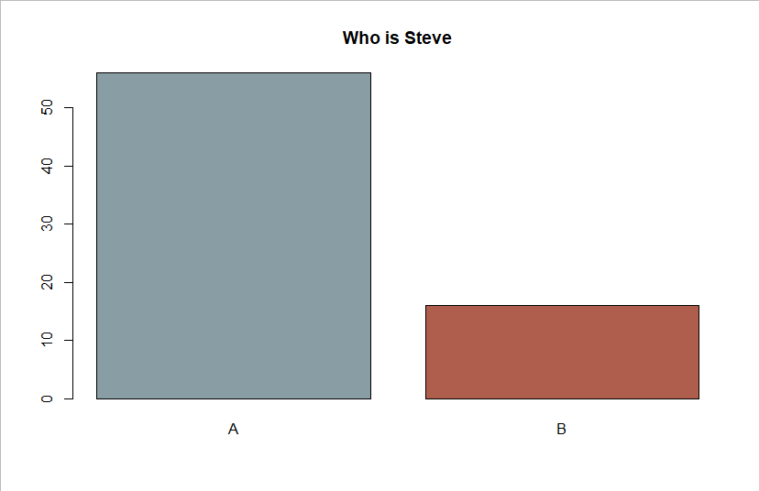
Steve

Slide 12
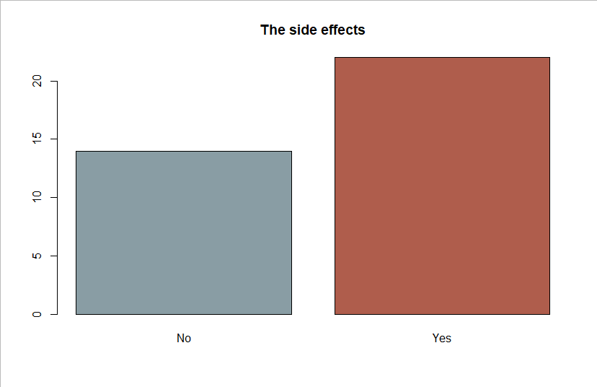
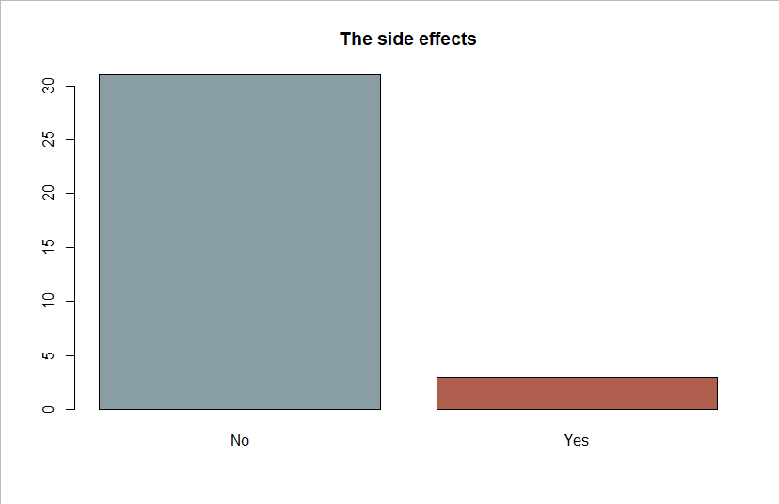
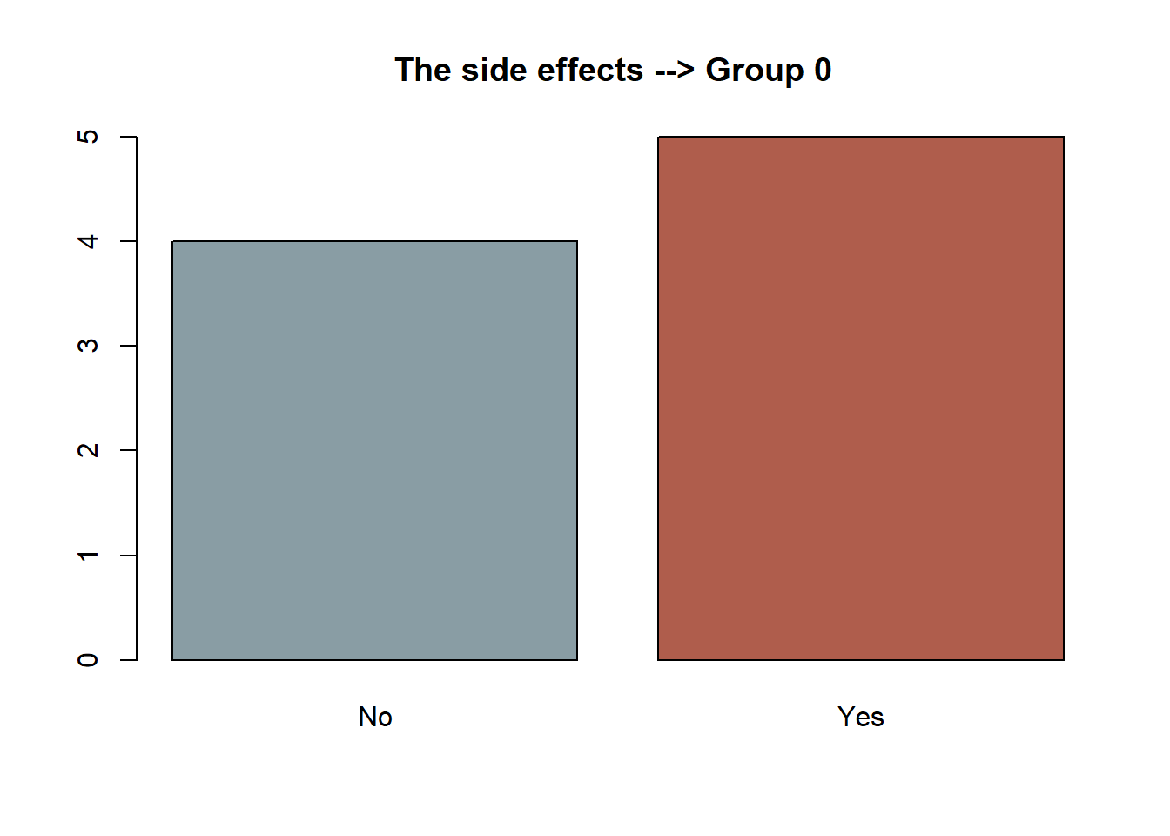
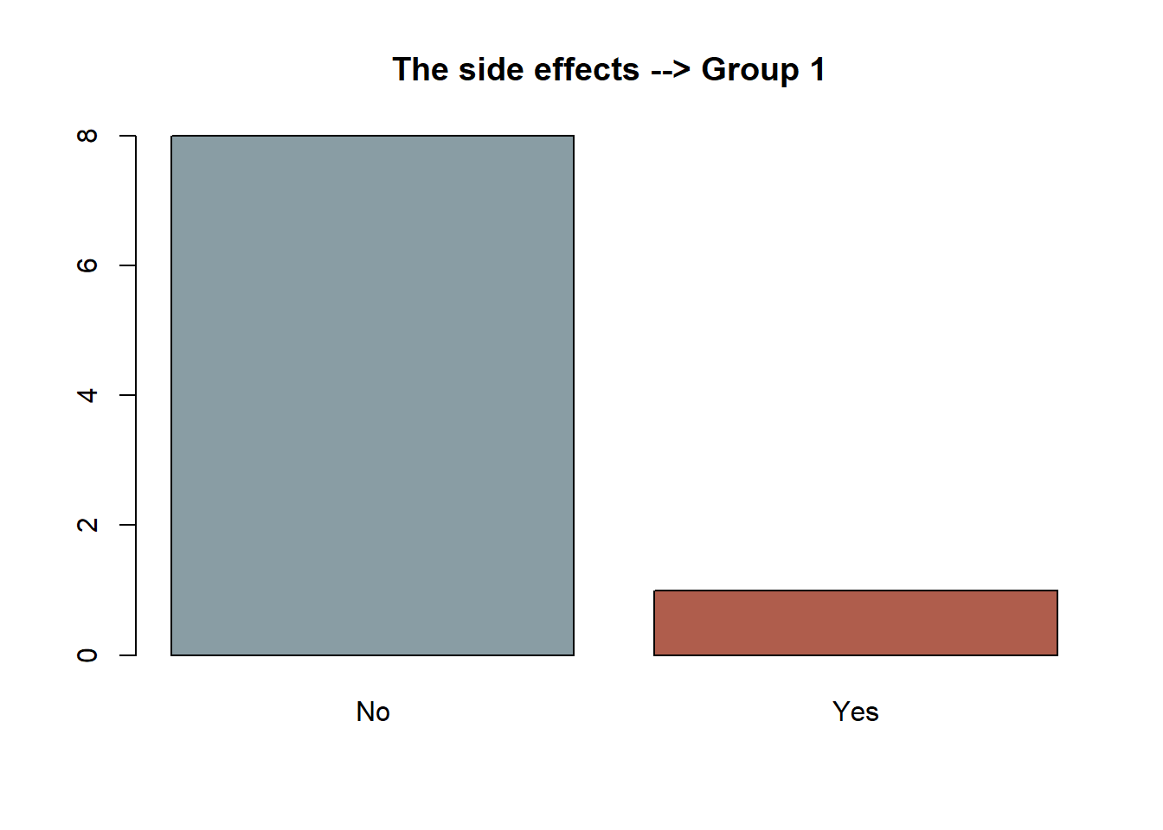
The side effects
To make a rational decision; you should have information about absolute risk increase.
Recent epidemiological studies have revealed that the side effects of the painkiller you use are more frequent than previously thought. Previous studies reported 1 in 100,000 liver injury. Now it is assumed that this is 2 in 100,000.
Recent epidemiological studies have revealed that the side effects of the painkiller you use are more frequent than previously thought. The likelihood of acute liver injury increased by 100%.
After such information, will you give up taking this drug?

Slide 13
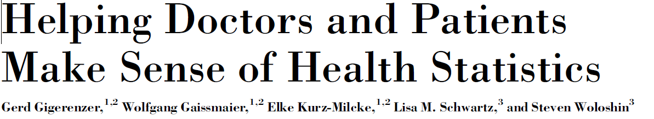
The side effects
In October 1995, the U.K. Committee on Safety of Medicines issued a warning that third-generation oral contraceptive pills increased the risk of potentially life-threatening blood clots in the legs or lungs twofold—that is, by 100%. This information was passed on in ‘‘Dear Doctor’’ letters to 190,000 general practitioners, pharmacists, and directors of public health and was presented in an emergency announcement to the media. The news caused great anxiety, and distressed women stopped taking the pill, which led to unwanted pregnancies and abortions (Furedi, 1999).
How big is 100%? The studies on which the warning was based had shown that of every 7,000 women who took the earlier, second-generation oral contraceptive pills, about 1 had a thrombosis; this number increased to 2 among women who took third-generation pills. That is, the absolute risk increase was only 1 in 7,000, whereas the relative increase was indeed 100%. Absolute risks are typically small numbers while the corresponding relative changes tend to look big—particularly when the base rate is low. Had the committee and the media reported the absolute risks, few women would have panicked and stopped taking the pill.
READ THE PAPER!!!!!!!!!!!!!!!!!

Slide 14
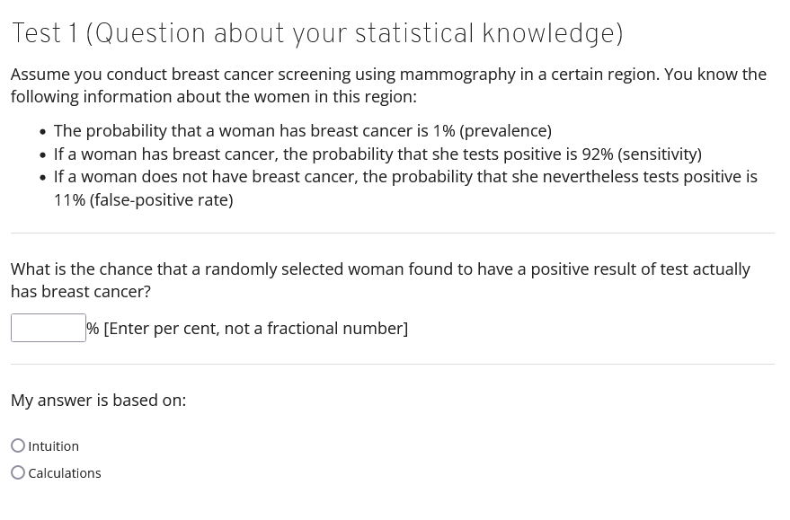
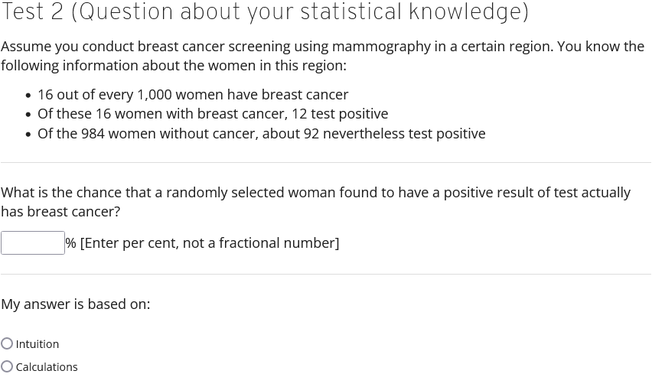
Two forms of two of question about testing

Slide 15
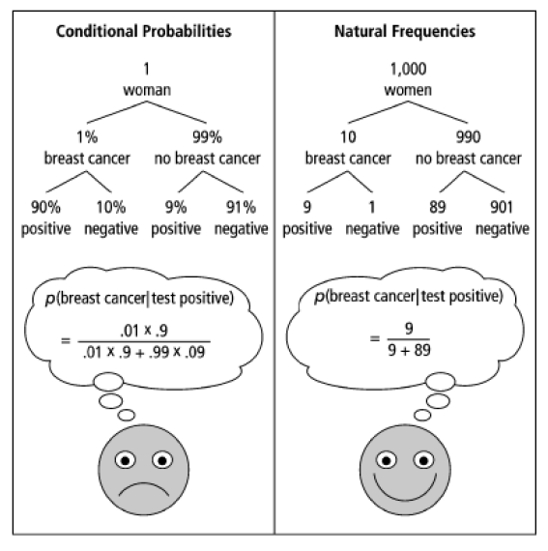
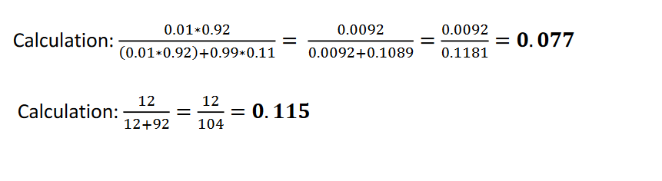
Two forms of two of question about testing
It is crucial how we present the problem. Even conditional probability [Bayes rule] can be explained with a simple drawing.
In your work, you will have to translate complicated things well to people without preparation. Be sure to read the guide on how to do it.

Slide 16
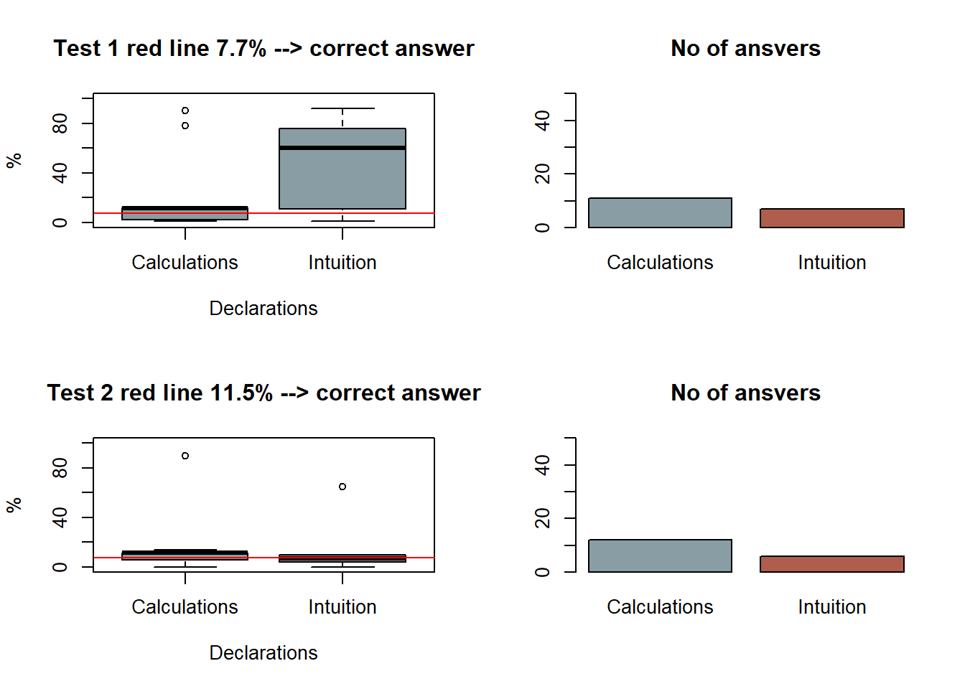
The test

Slide 17
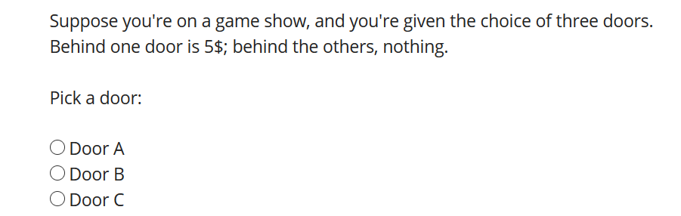
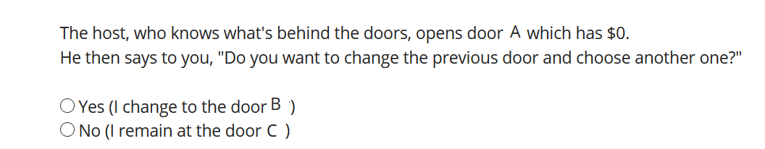
The Monty Hall problem
in the first stage you chose C :

Slide 18
The Monty Hall problem (vos Savant 1990)
It is a simple version of "Let’s Make a Deal" choice
Car (9000$)
1/3
1/3
Goat (0$)
1/3
Goat (0$)

Slide 19
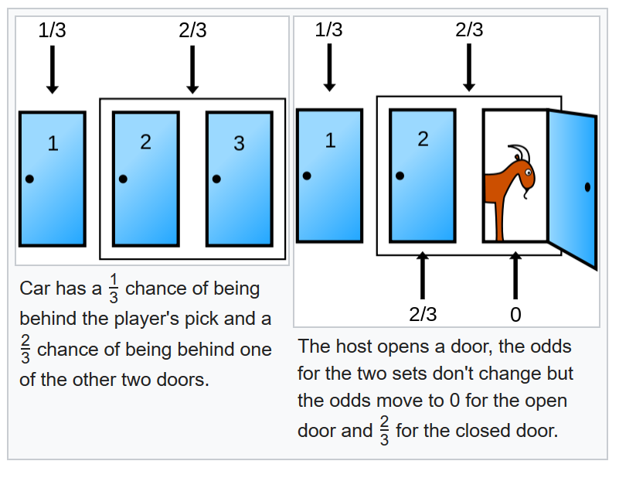
The Monty Hall problem (vos Savant 1990)
This problem is an example of how our intuition can fool us and therefore .... we are resisting for the explanation ...
We can see the simplest as possible explanation in Wikipedia:

Slide 20
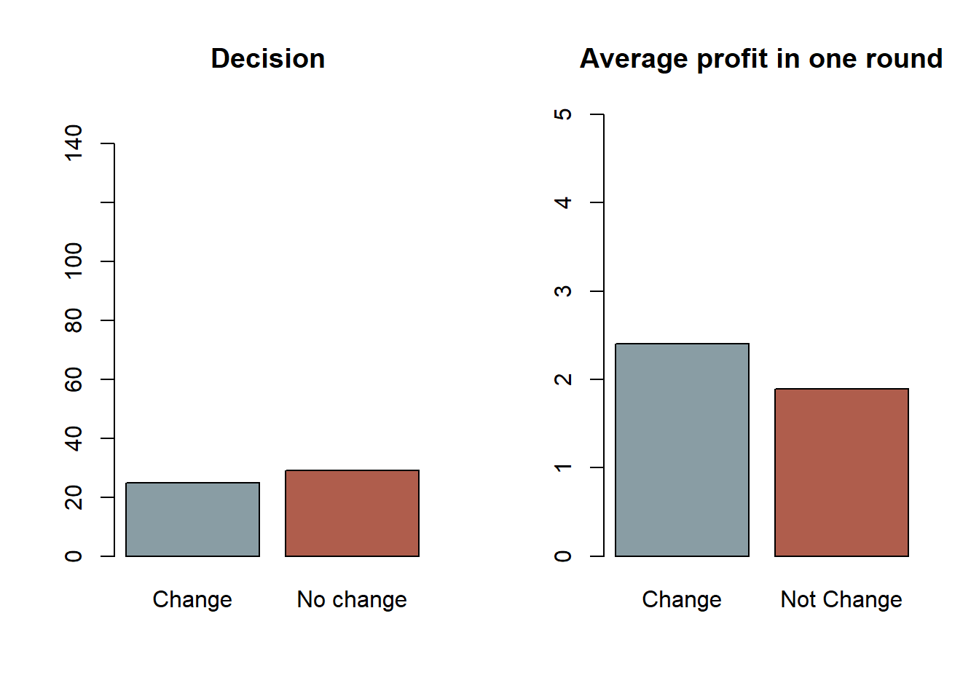
The Monty Hall problem
We can experience it.

Slide 21
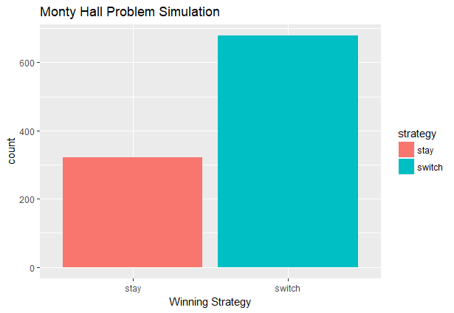
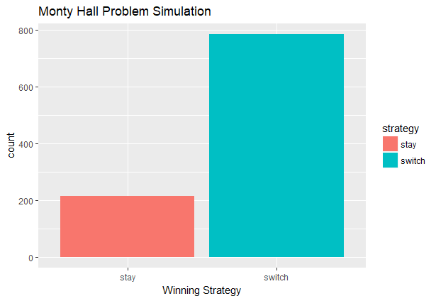
The Monty Hall problem (vos Savant 1990)
Results of MC symulations show that it is profitable to switch the door.
3 doors
###### Check, installation and loading of required packages #######
requiredPackages = c("dplyr", "ggplot2") # list of required packages
for(i in requiredPackages){
if(!require(i,character.only = TRUE)) install.packages(i)
library(i,character.only = TRUE) }
doors <- 1:5
sample_doors <- function() { return(sample(doors, size = 1000, replace = TRUE))}
games <- data.frame(prize = sample_doors(), pick = sample_doors())
games$strategy <- factor(ifelse(games$prize == games$pick, 'stay', 'switch'))
monte_show <- function(prize, pick) {
remaining <- setdiff(doors, c(prize, pick))
return(ifelse(length(remaining)==1,
remaining,
sample(remaining, 1)))
}
games <- games %>%
rowwise %>%
mutate(shown = monte_show(prize, pick),
stay = pick,
switch = setdiff(doors, c(pick, shown)),
strategy = factor(ifelse(prize == stay, 'stay', 'switch')))
qplot(strategy, data = games, fill = strategy, geom = 'bar') +
xlab('Winning Strategy') +
ggtitle('Monty Hall Problem Simulation')
# http://hoolihan.net/blog-tim/2017/03/22/simulating-monty-hall-problem-r/
5 doors

Slide 22
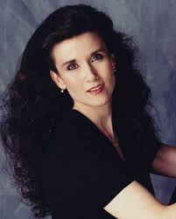
The Monty Hall problem (vos Savant 1990)
Even if an artist showed you the solution the problem would be controversial and you do not trust statistics. https://www.youtube.com/watch?v=GPoPSNxV1D4&t=221s
And we still have a problem with the problem.
Stereotypes once again:
Marilyn vos Savant ignited one of the most heated statistical battles of the 20st century.
When vos Savant politely responded to a reader’s inquiry on the Monty Hall Problem, a then-relatively-unknown probability puzzle, she never could’ve imagined what would unfold: though her answer was correct, she received over 10,000 letters, many from noted scholars and Ph.Ds, informing her that she was a hare-brained idiot.
https://priceonomics.com/the-time-everyone-corrected-the-worlds-smartest/
http://marilynvossavant.com/forum/viewtopic.php?f=4&t=34

Slide 23
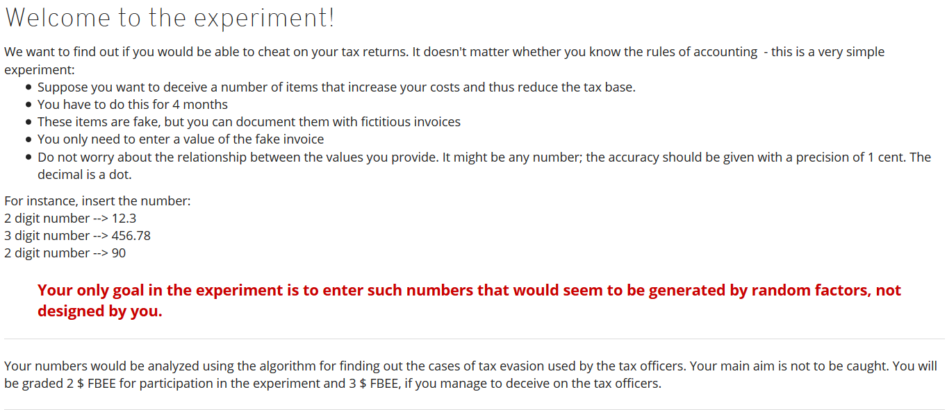
Problem with the perception of the probability Try to fool the tax officer

Slide 24
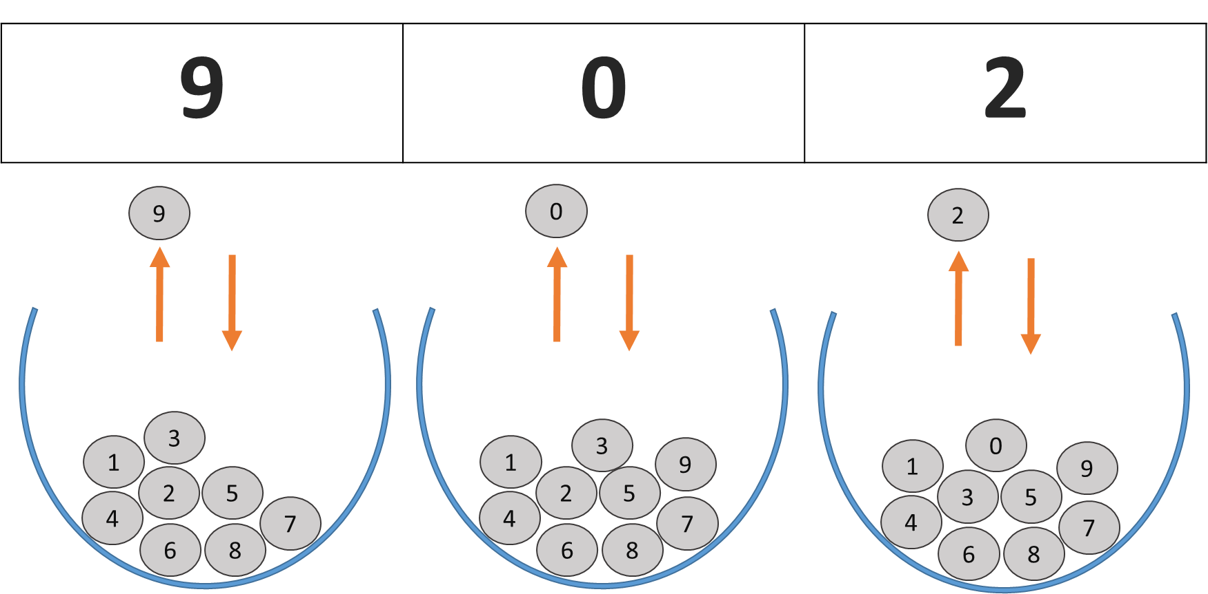
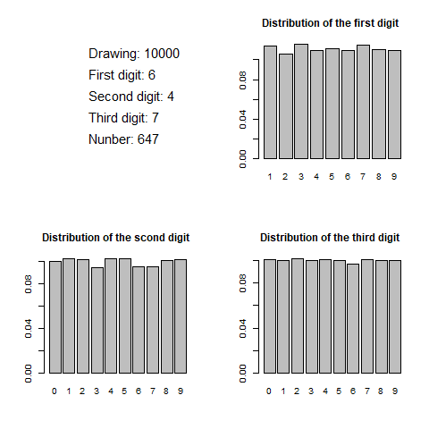
Experiment: Intuition
It seems that we should randomly select digits as if we were conducting a drawing with replacement of numbered balls from an urn.
Can we generate such random numbers based on our intuition?

Slide 25
Intuition is not reliable—especially when it comes to randomness
This intuition is misleading—even if we generated the numbers in Excel, the tax office would still catch us cheating.
Sometimes natural processes generate random numbers, but they cannot be approximated by drawing from an urn—this is especially true for the first digit.

Slide 26
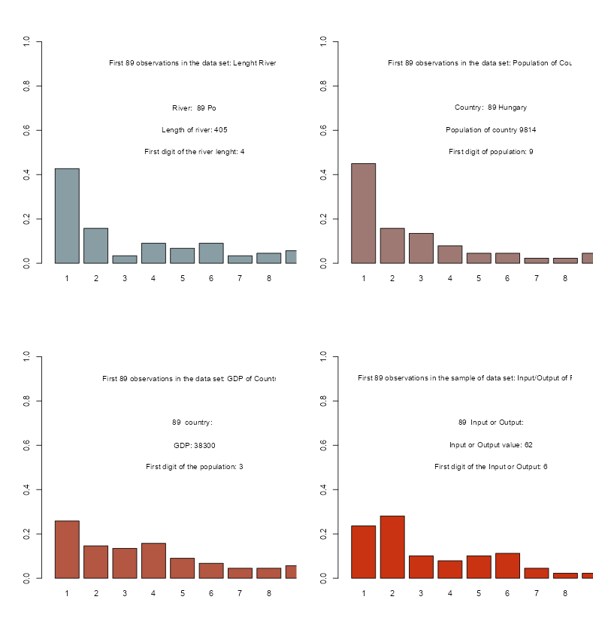
Intuition is not reliable—especially when it comes to randomness
Simulation of adding the following numbers to the analysed set and determining the frequency of digits in the first position. Even with fewer than 100 observations, a specific pattern emerges.
The digit 1 appears in the first position much more frequently than other digits, and the larger the digit, the lower the frequency of its occurrence. [Changing units does not disturb this distribution]

Slide 27
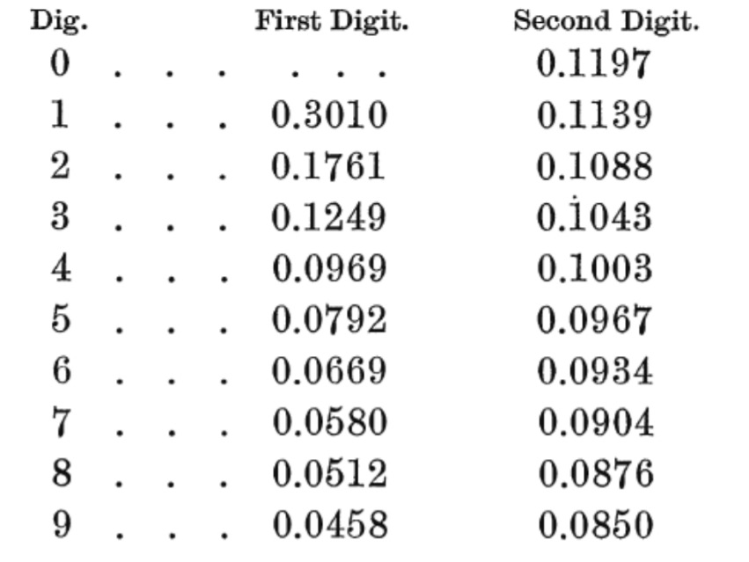
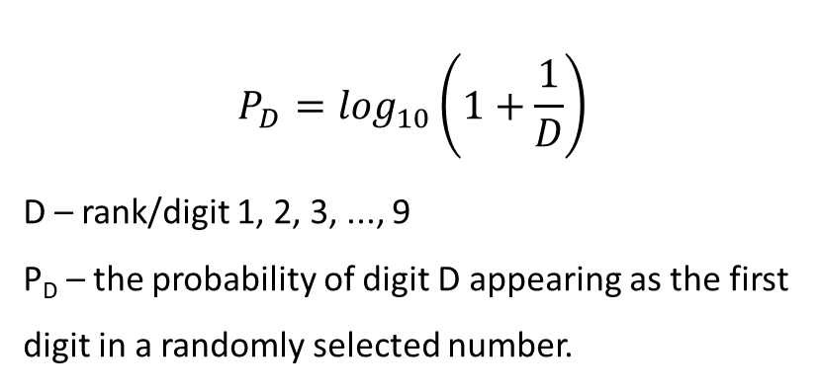
Benford Newcomb 's Law
This phenomenon is called Benford's Law, named after physicist Frank Benford, although it was actually first documented by Simon Newcomb, a Canadian mathematician and astronomer, much earlier. In 1881, Newcomb discovered that when using logarithmic tables, the earlier pages (which contained numbers starting with 1) were much more worn than the other pages. Benford rediscovered this observation in 1938. Newcomb-Benford's Law states that if we randomly select a number from a table of physical constants or statistical data, the probability that the first digit will be "1" is about 0.301, not 0.1, as we might expect if all digits were equally probable.
$$P_{D}=\log_{10}\left(1+\frac{1}{D}\right)$$
D – rank/digit 1, 2, 3, ..., 9
P_{D}​ – the probability of digit D appearing as the first digit in a randomly selected number.

Slide 28
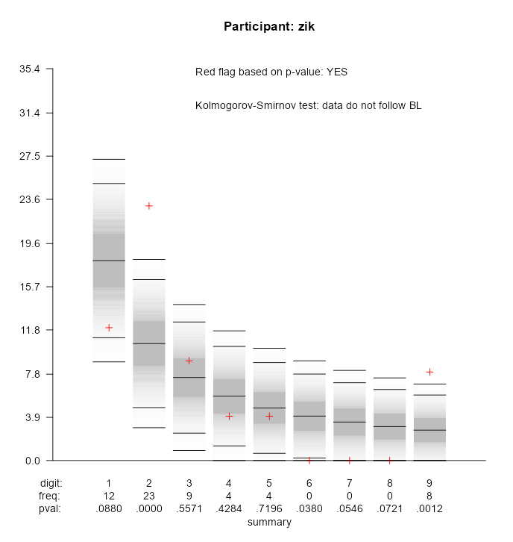
Benford-Newcomb's Law
Testing for fraud and data quality
Thanks to this law, we are able to check whether the data we are using:
Is not falsified (fake data)
Has the appropriate quality
In the report, you can see if I caught you cheating. If not, you can claim your reward.
The middle line on the dark background represents the "theoretical frequency of a given digit appearing in the first position." The red cross marks the frequency of the digits in the data you entered.
Zik should have entered 1 eighteen times, but entered it twelve times in the first position.

Slide 29
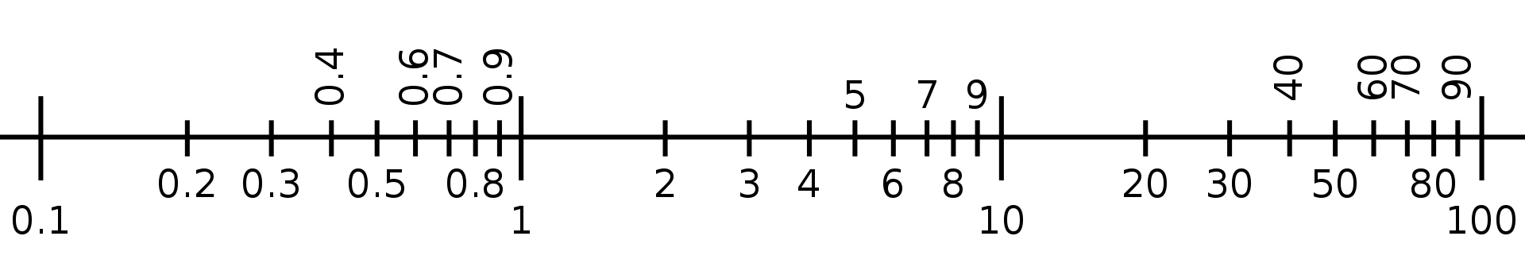
How can this law be explained?
Starting from Simon Newcomb's discovery, we could limit ourself to stating: this is the result of the adopted decimal notation. If we represent on an axis how values are distributed in logarithmic tables, indeed, the probability that any number starts with 1 (red area) is much greater than that it starts with the digit 8 (green area).

Slide 30
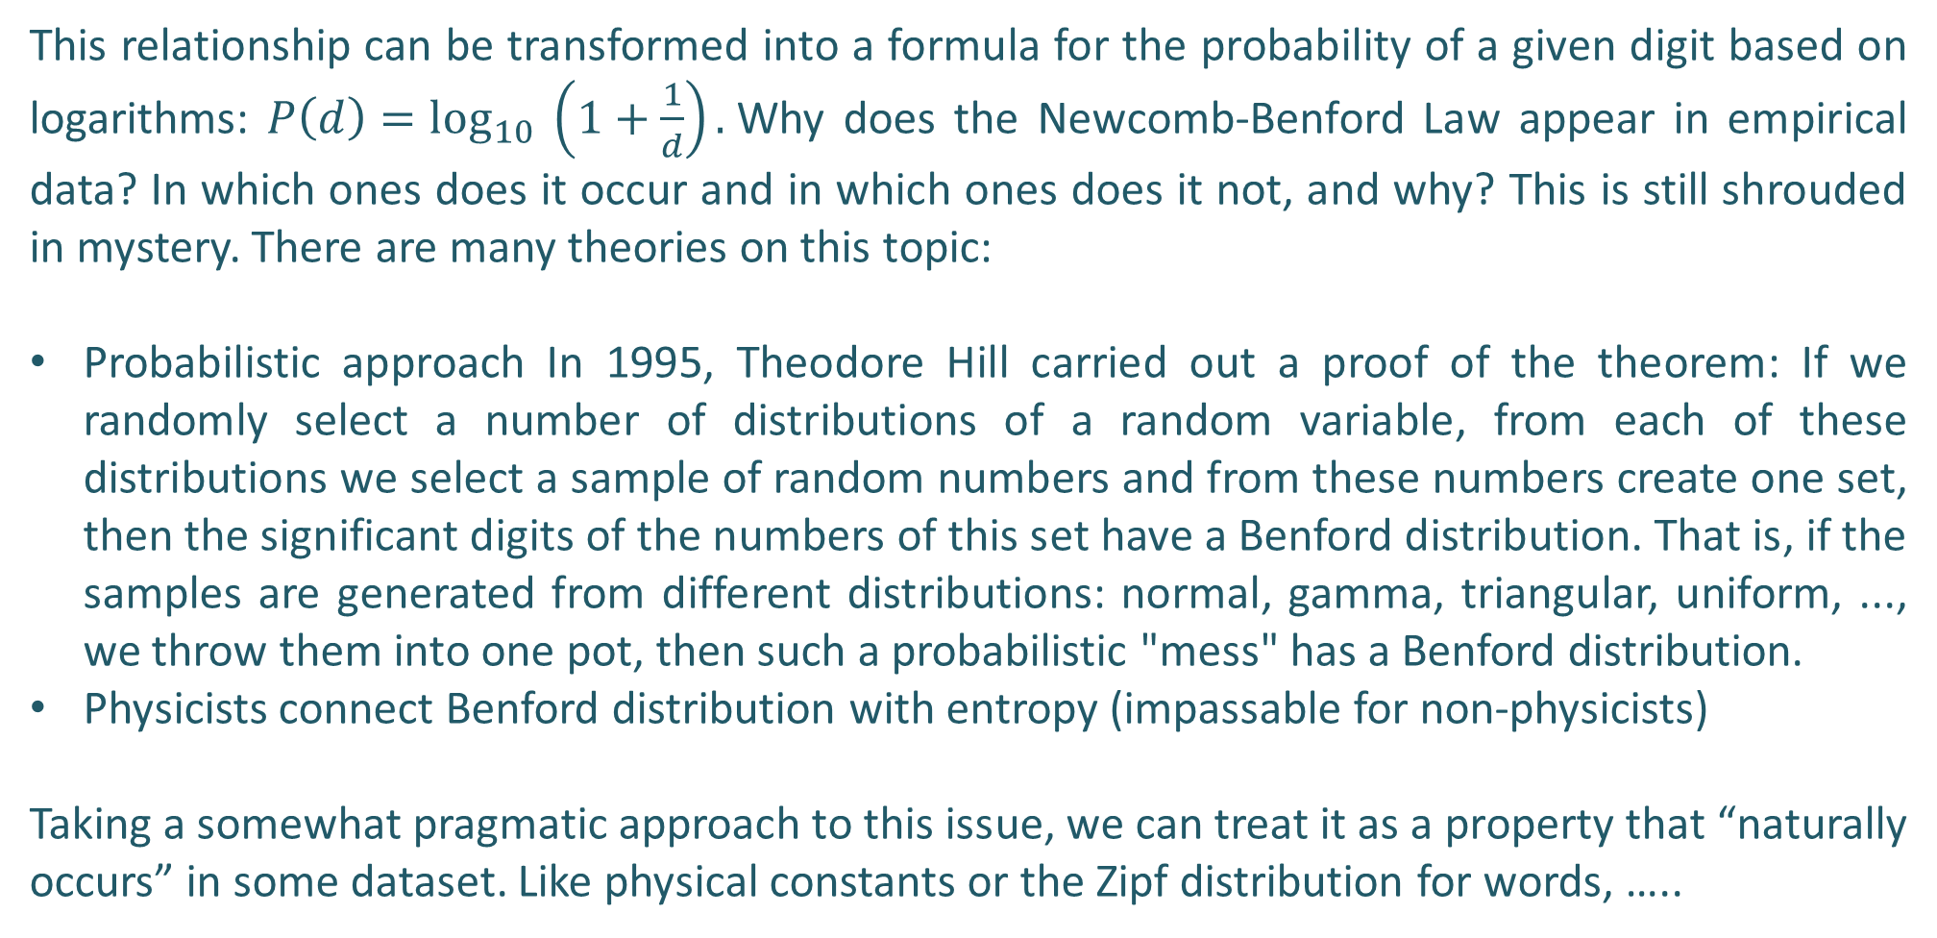
How can this law be explained?
This relationship can be transformed into a formula for the probability of a given digit based on logarithms: $P\left(d\right)=\log_{10} \left(1+\frac{1}{d}\right).$Why does the Newcomb-Benford Law appear in empirical data? In which ones does it occur and in which ones does it not, and why? This is still shrouded in mystery. There are many theories on this topic:
Probabilistic approach In 1995, Theodore Hill carried out a proof of the theorem: If we randomly select a number of distributions of a random variable, from each of these distributions we select a sample of random numbers and from these numbers create one set, then the significant digits of the numbers of this set have a Benford distribution. That is, if the samples are generated from different distributions: normal, gamma, triangular, uniform, ..., we throw them into one pot, then such a probabilistic "mess" has a Benford distribution.
Physicists connect Benford distribution with entropy (impassable for non-physicists)
Taking a somewhat pragmatic approach to this issue, we can treat it as a property that “naturally occurs” in some dataset. Like physical constants or the Zipf distribution for words, …..

Slide 31
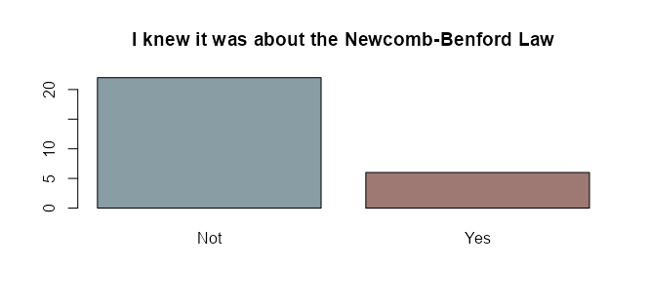
Questionare: perception of fake data
No one has won the gadget so far - everyone has been caught, even someone who knows the N-BL.
This is a good/ethical narrative - a simple test can be used to recognize fake data.
We can do it and we should do it. And what is the perception of fake data/research among DS students?

Slide 32
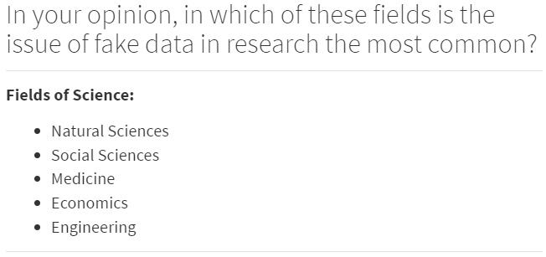
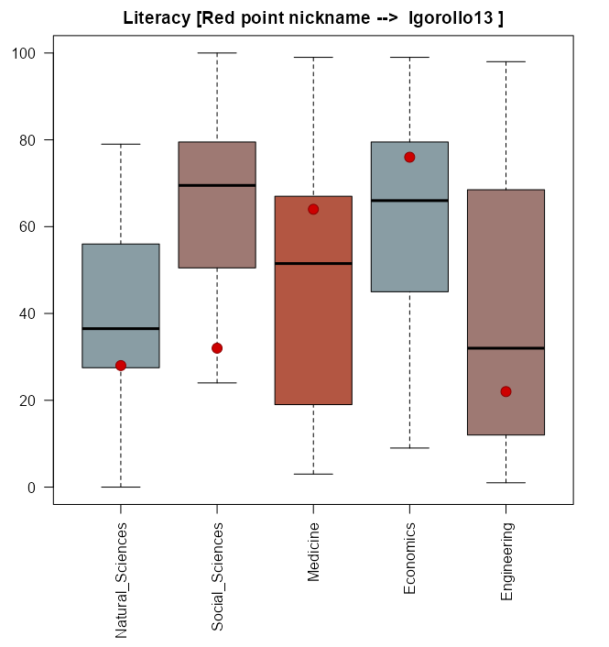
Questionare: perception of fake data
Student perception: In economic and social sciene It is a widespread phenomenon, and most data is falsified.

Slide 33
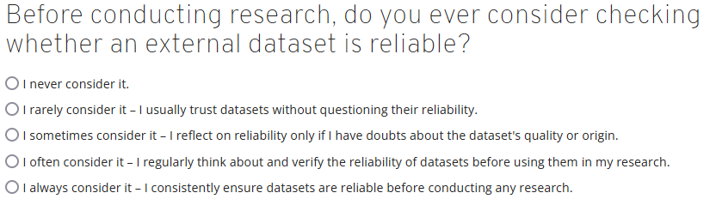
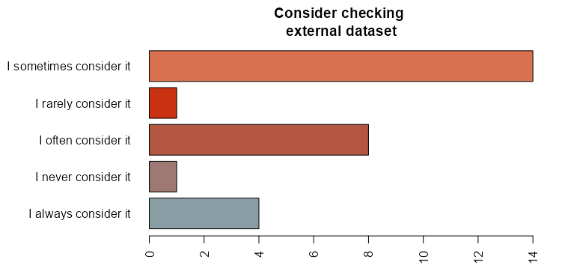
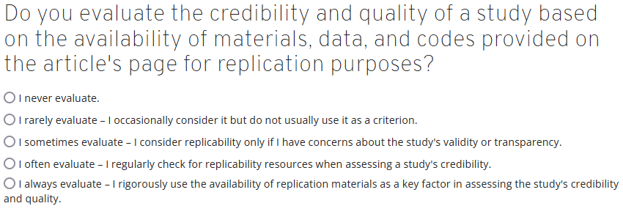
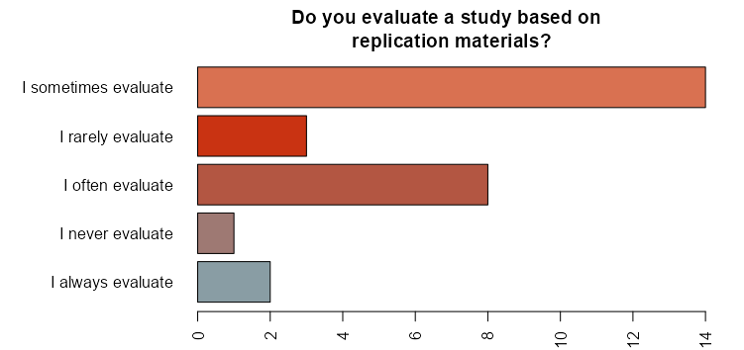
Questionare: perception of fake data
For Data Science students, the results are somewhat concerning: you tend not to evaluate the credibility of data and research.

Slide 34
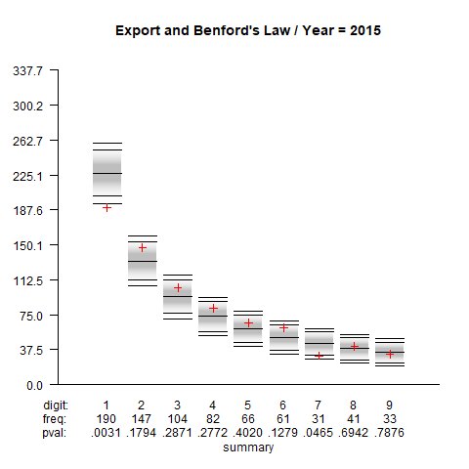
The quality of data
Our own example applying the dataset for analysis of international trade determinants
Data related to the volume of export, import, GDP, population volume, etc. (taken from World Bank and IMF mainly). 14 years, 3366 pairs of trading partners.
8 variables, 47124 observations, and approximately 376 992 numbers in total
Below you can see the frequency of the first number distribution in 2015

Slide 35
The quality of data
Forum topic: What do you think about Polish accounting regulation?
According to the rules, taxpayers will be obligated to implement a Standard Audit File for Tax (SAF-T).
Who will check the files? → Data Scientist

Slide 36
It's not just teaching --> Two-way flow of knowledge <--
My goal is to open widely a two-way flow of knowledge:
From economic research and theory to education - I try to find a way to translate complex economic concepts into everyday behaviour.
From education to theory - I study how this economic knowledge is absorbed by people - mainly how experience and collective knowledge affect the perception of economic problems
Additional inspiration – explore if you feel like it!

Slide 37
It's not just teaching --> Two-way flow of knowledge <--
Teaching can also be a process of scientific discovery. Two examples:
A simple Monte Carlo simulation generating a Benford distribution
A study of whether N-BL works in geographical/socio-economic space
Additional inspiration – explore if you feel like it!

Slide 38
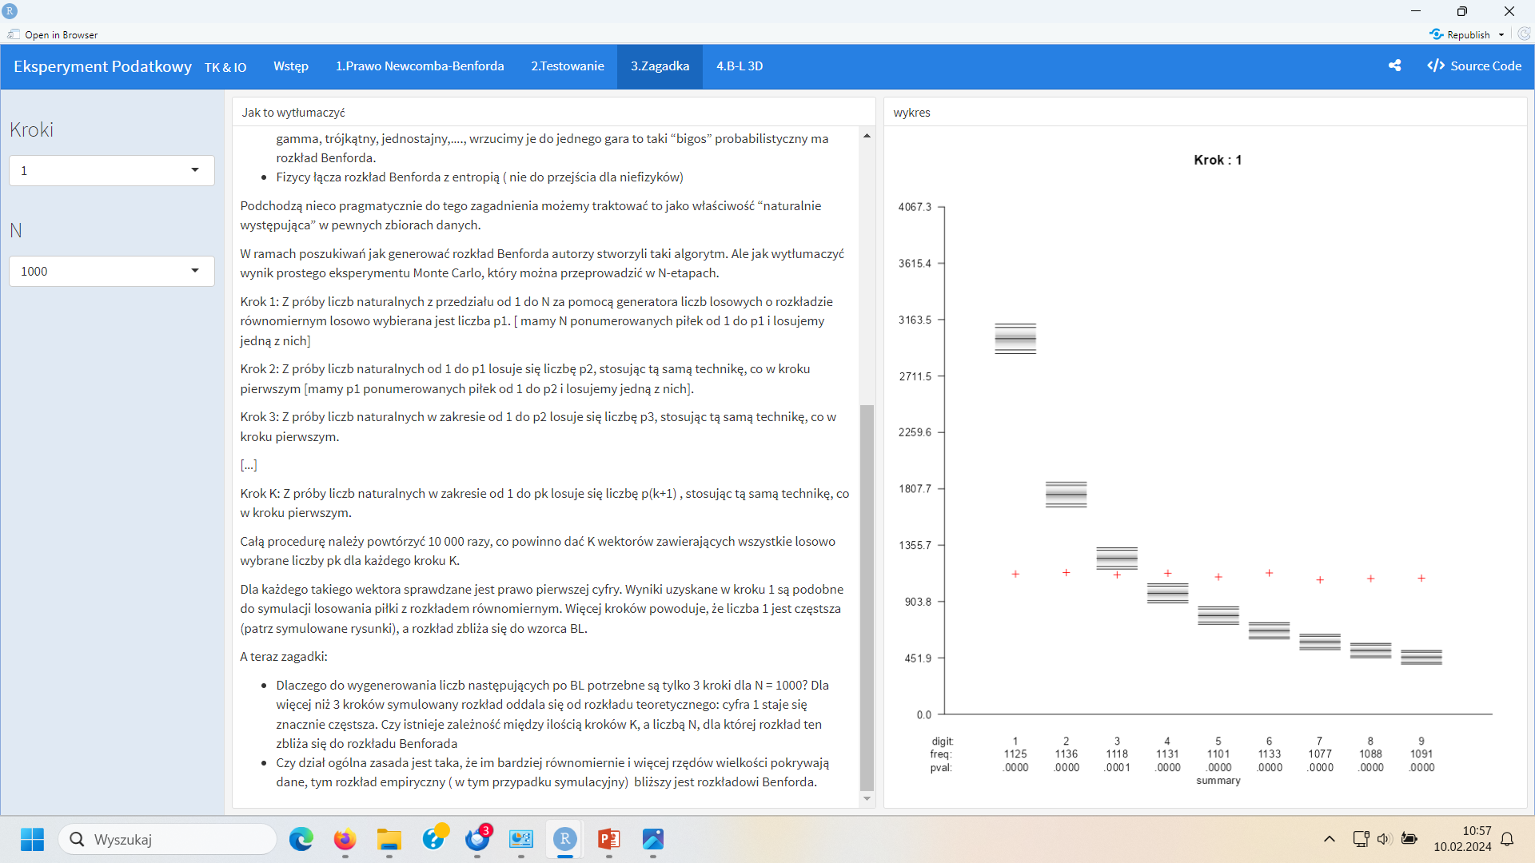
How can the results of a simple Monte Carlo experiment be explained?
As part of my search for how to generate a distribution [compatible with Benford distribution], I created such an algorithm - a simple Monte Carlo experiment that can be performed in K-steps. It can be run in the report:
Puzzles continued:
Why are only 3 steps needed to generate numbers following N-BL for N = 1000? For more than 3 steps, the simulated distribution moves away from the theoretical distribution: the number 1 becomes much more frequent.
Is there a relationship between the number of steps K and the number N for which this distribution approaches the Benford distribution?
The general rule is that the more evenly and by more orders of magnitude the data cover, the closer the empirical distribution (in this case, the simulation) is to the Benford distribution.
Additional inspiration – explore if you feel like it!

Slide 39
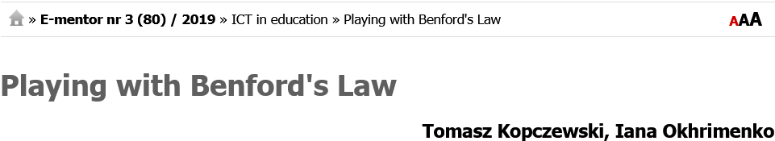
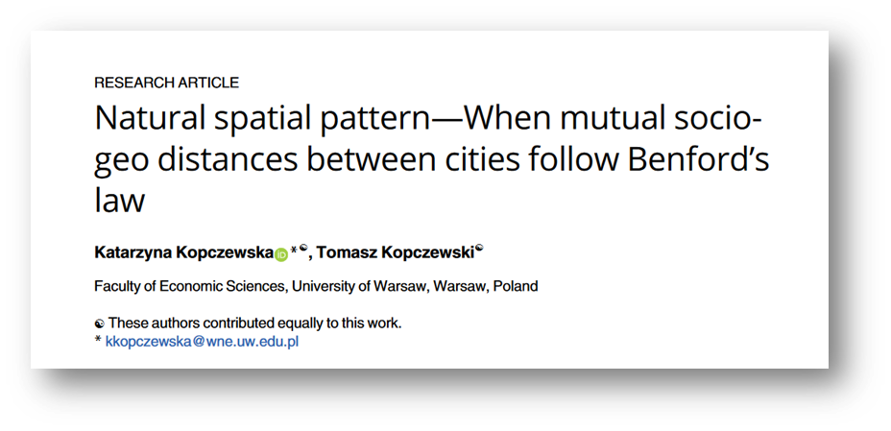
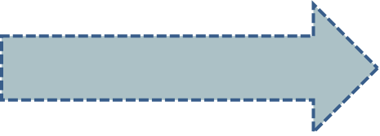
It's not just teaching --> Two-way flow of knowledge <--
I am presenting this experiment as the first one from the series because it is the first topic where I closed the loop from theory to education and from education to research.
Additional inspiration – explore if you feel like it!

Slide 40
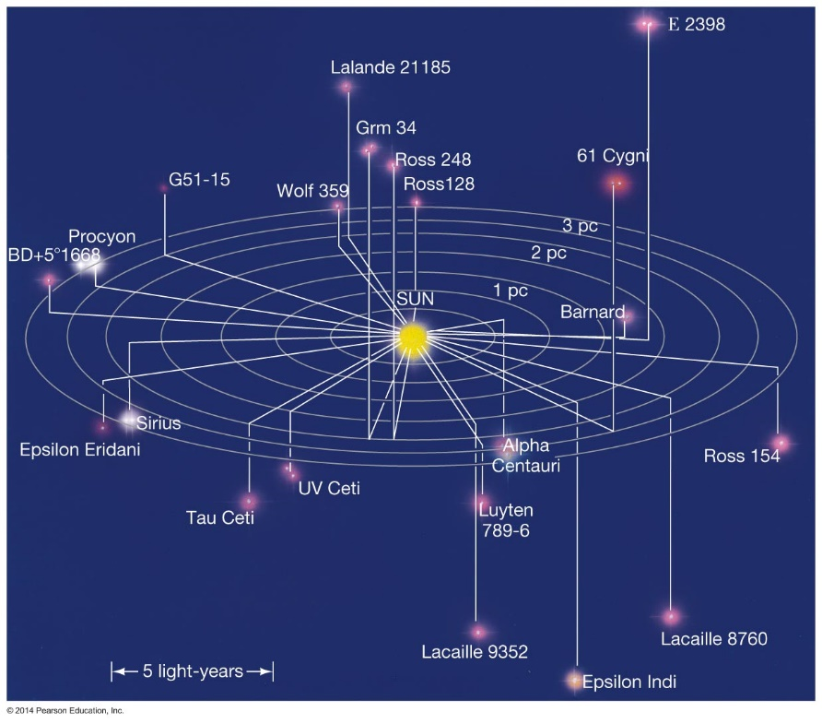
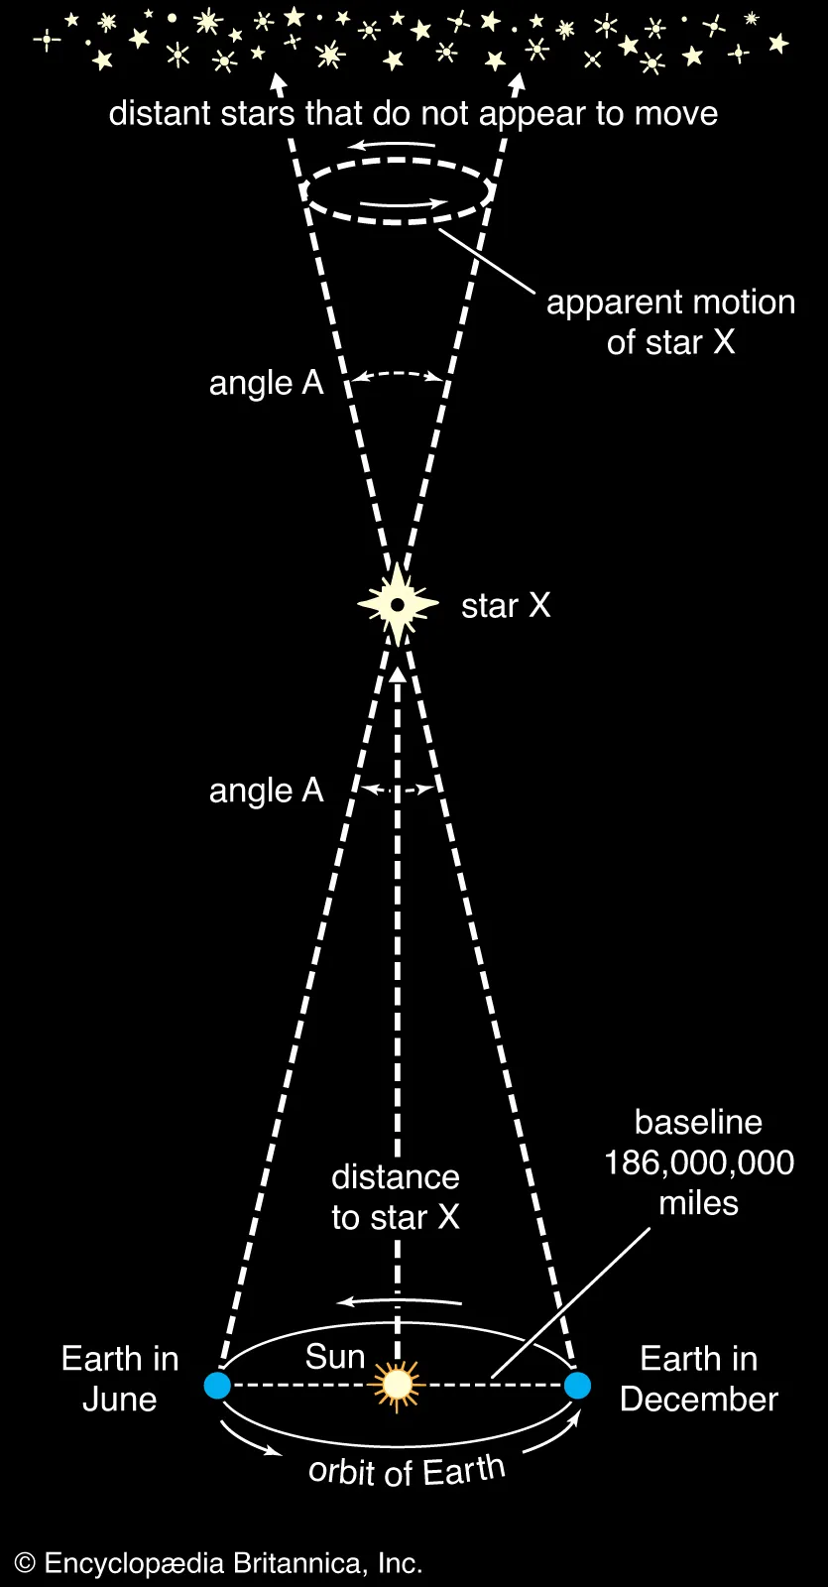

Benford-Newcomb's Law; terra incognita
Tens of thousands of articles exist on Bedford's Law (BNL) and its applications - however, only a few focus on space and distances between objects.
Several attempts have been made to apply Benford-Newcomb’s Law in astronomy, but they have failed.
Distances between stars do not obey this law.
In geography, the distance between cities does not obey the law either.
Additional inspiration – explore if you feel like it!

Slide 41

Benford-Newcomb's Law; another way to define space
Idea:
if (Euclidean) distances do not satisfy Benford-Newcomb's law in geographic space, then we may need to change the definition of space.
Two dimensions will be geographic (longitude and latitude) and the third social (size of cities). We still calculate Euclidean distance, but in 3-dimensional space.
We can do the same for stars in 4-dimensional space -> 3D mutual position and mass.
Additional inspiration – explore if you feel like it!

Slide 42


Benford-Newcomb's Law; another way to define space
From idea to implementation
First, you need to collect data and consolidate:
42,028 cities in 169 countries. The number of cities per country varies from 11 to 1,000
Calculate the distances between all cities in 3d space
$\frac{n_{i}^{2}− n_{i}}{2}$ = 883 155 378 distances of the form:
Determine the "state of the art" in statistical testing of Benford-Newcomb's law
Perform testing and visualize the results.
Additional inspiration – explore if you feel like it!
What is the result?
Does the distance defined in this way satisfy Benford's Law?

Slide 43

Benford-Newcomb's; result 1
WOW!!
We were the first in the world to discover that Benford's law also works in space.
Additional inspiration – explore if you feel like it!

Slide 44

Benford-Newcomb's law; result 1
And statistically, this is a significant relationship and the more cities there are in a given country, the stronger the relationship.
Nature did not accept this article, but we are still happy, especially since ……
Additional inspiration – explore if you feel like it!

Slide 45
Benford-Newcomb's law; result 2
……, that it does not work with the same “strength”. And we can interpret why this is so.
Try to find this relationship yourself.
Additional inspiration – explore if you feel like it!

Slide 46
Benford-Newcomb's law; result 2
Hypothesis:
in countries where the emergence of cities was determined by natural processes, the BN law is more "stronger".

Slide 47

Benford-Newcomb's law; result 2
And it does not depend on the characteristics of the city formation process and the influence of natural factors.
Additional inspiration – explore if you feel like it!

Slide 48

Benford-Newcomb's law; result 3
Is it possible to reconstruct the spatial distribution of cities as a composite of distributions well known in spatial statistics using historical literature? [Probabilistic approach of Theodore Hill ]
Ordered: transport network (1 day of travel by horse), influence of local power centers (principalities)
Additional inspiration – explore if you feel like it!
Random: distribution of natural resources and religious centers
Clustered: the formation of agglomerations, the effect of good location and the network effect.
Siemianowska E. O zastosowaniu niektórych modeli teoretycznych w badaniach nad ośrodkami miejskimi w średniowieczu. Archaeologia Historica Polona. 2014; 22, 27–54 (2014).

Slide 49


Benford-Newcomb's law; result 3
It was possible to find such a composition of theoretical distributions as to reproduce the Benford distribution in space.
Take:
~70% clustered
~20% ordered
~10% random
to get a natural spatial distribution of cities.
Additional inspiration – explore if you feel like it!

Slide 50


Zipf's distribution
Zipf's distribution (law) - in many natural data sets, the frequency of an item is inversely proportional to its rank.
Language analysis: frequency of words. The most common word will occur approximately twice as often as the second most common word, three times as often as the third most common word, ...
Computer science: the distribution of file lengths in computer systems.
Economics: the distribution of cities by population. [ it is not our research]
Social networks: the number of connections of individual users.
https://www.wordcount.org/main.php

Slide 51

History / How deal with risk?
The problem is that the statistics and probability is a quite new subject of science and the part of the knowledge was forgotten for almost one hundred years.
Blaise Pascal 1623 - 1662
Pascal wanted to answer the question: How to choose between lotteries? The simplest criterium was the comparing the expected values of the lotteries.
E(lottery A ) >=< E(lottery B )
E(S) = 1*900
E(G) 2/4 * 0 + 1/4 * 1000 + 1/4 * 11 000
S
1
$ 900
kill(all);
load (descriptive);
MS: 900$ MG1 : 0$ MG2: 1000$ MG3: 11000$
/* Lotery: LS with probability 1/1 */
LS: append(makelist(MS,1));
/* Lotery: MG1 with probability 2/4, MG2 with probability 1/4 and MG3 with probability 1/4 */
LG: append(makelist(MG1,2), makelist(MG2, 1), makelist(MG3,1));
print( "E(LS) =", float(mean (LS)))$
print( "E(LG) =", float(mean (LG)))$
$ 0
1/4
$ 0
1/4
G
1/4
$ 1000
1/4
$ 11 000
For how many gates with zero prize will lottery S be better than lottery G?

Slide 52
History
The best-known Pascal's bet - is the comparison of two lotteries ☺
There is God
Infinite gain – costs of believing
Believe in God
p
1-p
There is no God
- costs of believing
There is God
+ gains of not believing
Not believe in God
p
1-p
There is no God
+ gains of not believing
This comparison you should do it by yourself :)

Slide 53


I tested students’s understanding and use of the expected value concept.
Distribution of the declarations whether the answer was based on intuition or calculation
Distribution of time spent to answer each question.

Slide 54
History / How deal with risk?
The expected value criterion should work fine and can be used to pricing the lottery. Example: How much will be worth for you the ticket to participate in the game:
Flip a fair coin until you get tails. Let n be the number of flips it took. Your prize is 2ⁿ PLN.
Examples:
If tails comes on the first flip (n = 1), you win 2¹ = 2 PLN.
If you get heads, you flip again.
If tails comes on the second flip (n = 2), you win 2² = 4 PLN.
If you keep getting heads, you keep flipping, and the prize keeps doubling each time.
In principle, the game can last for any number of flips.

Slide 55
History / How deal with risk?
Who has the biggest valuation?
You can buy the ticket for the lottery and play with me (for real)

Slide 56

The St. Petersburg Paradox
The problem is that using the expected value criterium you should give me all your assets. The expected value is equal to infinity.
sum ((1/2^i)*2^i, i, 1, inf);
The St. Petersburg Paradox
Nicholas Bernoulli found the paradox when he was working in Russia.

Slide 57

The St. Petersburg Paradox
The paradox still is a subject of research. The simulations show that for the finite game the value of it is quite small.
PlayGame <- function(winnings=0, turn=1) {
if(sample(0:1, 1)) {
winnings <- winnings + (2^turn)
turn <- turn + 1
PlayGame(winnings, turn)
}
else {
winnings
}}
RunSimulation <- function(timesToPlay, ticket.price ) {
results <- rep(NA, timesToPlay)
results2 <- rep(NA, timesToPlay)
rollingAvg <- rep(NA, timesToPlay)
for(i in 1:timesToPlay) {
results[i] <- PlayGame() - ticket.price
rollingAvg[i] <- mean(results[1:i])
}
par(mfrow = c(1, 2))
plot(results, type="l", xlab="Trials", ylab="Net income", main = "Net income in trials")
plot(rollingAvg, type="l", xlab="Number of Trials", ylab="Rolling Average", main="Rolling Average of net income")
par(mfrow = c(1, 1))
}
RunSimulation(timesToPlay = 2000, ticket.price = 4 )
# https://gist.github.com/grano/fc854a2ffb2d6af8793b
One of the last statement about the paradox: Clark (2002: 176) “This seems to be one of those paradoxes which we have to swallow.”

Slide 58

The St. Petersburg Paradox
Daniel Bernoulli found how we can handle the paradox and created the foundation of the modern expected utility theory.
the utility function is not linear function of wealth
the valuation of risky games is according to the expected utility of the game not value of the expected game, but
He used the simple logarithmic function.

Slide 59

The St. Petersburg Paradox
He used cardinal measure of utility not ordinal.
The greater the wealth, the larger the lottery valuation.
See paper: Bernoulli.pdf

Slide 60

Rediscovery
.......... and the theory was forgotten for centuries until ……….
Oskar Morgenstern
John von Neumann
They identified rational choice axioms and presented the expected utility theorem in which a decision-maker is maximizing the value of the expected utility function.

Slide 61
lottery
The player chooses between lotteries and for each of them:
He knows (a'priori) all the events that can happen in each lottery
Z1, Z2, .... , Zk
These events are exclusive (fish is not able to be partially fresh / fresh or bad)
He/she knows the probabilities of these events p1, p2, ...., pk
Nature generate the probabilities / the player is not able to influence them.
The sum of the probabilities is equal to one. One of the events has to happen.
He/she knows a'priori the payout values of each event: x1, x2, ...., xk
Payouts do not change and they are determined by nature. The behaviour of player does not change the payouts.

Slide 62
lottery
The way the lottery is presented does not affect the choice. The perception of the lottery depends only on the net probabilities of events --> a complex/compound lottery can be simplified.
x₁
x₁
p
qp
q
q-qp
x₂
1-p
x₂
1-q
1-q
x₃
x₃

Slide 63
lottery
The way the lottery is presented does not affect the choice.
The player has full information and ability to calculate every statistics which characterize the lottery.
[Try to calculate an expected value and variance, at once for each lottery :)]

Slide 64
Task: Reduction of Compound Lotteries
Which lottery do you prefer?
1000
0.2
0.5
0.8
A
400
300
0.5
0.4
100
B
0.6
350

Slide 65


Task: Reduction of Compound Lotteries
You should be able to reduce the compound Lotteries and
calculate every statistics which characterizes the lottery.
1000
0.2
1000
0.1
0.5
0.8
A
0.4
400
A
400
0.5
100
0.5
kill(all);
load (descriptive);
lotery : [100,100,100,100,100,400,400,400,400,1000];
mean (lotery);
var (lotery), numer;
100
250
0.4
kill(all);
load (descriptive);
lotery : [250,250, 350,350,350];
mean (lotery);
var (lotery), numer;
B
0.6
350

Slide 66
Axioms of rational choice:
COMPLETENESS
For each of the two lotteries L1 and L2:
L1≻L2 or L2≻L1 or L2 ~ L2
TRANSITIVITY
If the player L1≻ L2 and L2 ≻ L3, then L1 ≻ L3
CONTINUITY
If payofs y1 ≻ y2 and y2 ≻ y3, then
there is a 0 <t <1 for which L1 ~ L2, where
L1 = [(0, y1); (1, y2)]
L2 = [(t, y1); ((1-t), y3)]
INDEPENDENCE FROM IRRELEVANT ALTERNATIVES
If the payments y1 ≻(~) y2 and y3 will be any other payment,
for each 0 <t <1 lotteries: L1 = [(t, y1); ((1-t), y3)], L2 = [(t, y2); ((1-t), y3)]
the L1 ≻(~) L2 will be valued the same.
MONOTONICITY
If payouts y1 ≻ y2 and L1 = [(p1, y1), (1-p1, y2)], L2 = [(p2, y1), (1-p2, y2)], then L1 ≻ L2, when p1> p2 (a lottery is preferred, for which the probability of winning y1 is higher)

Slide 67

von Neumann-Morgenstern utility function
By satisfying the axioms of the rational choice, individual preferences can be represented by the VNM (von Neumann-Morgenstern) function;
The VNM function assigns values to lotteries L1 and L2 in such a way that
EU(L1)> EU(L2) <=> L1 ≻ L2
The utility function VNM is a function-weighted probability utility function depending on the state of wealth
EU (L1) = $\sum_{i=1}^{k}{p_{i}U(x_{i})}$

Slide 68
Are you rational?
Economists and psychologists Kahneman and Tversky, Allais, Savage, and.... conducted different experimental studies and showed that people do not follow rational choice's axioms. And these are not just random cases.
The behavioral economics shows the existence of irrationality. There is some tendency to do systematic errors (cognitive biases). These errors can be investigated.
The economic theory can not deny the existence of those cognitive biases and we should not deny it in our life too.

Slide 69
Exp 1
What lottery do you prefer?
27 500
0.33
A
24 000
B
1
24 000
0.66
0.01
0

Slide 70
Exp 1
What lottery do you prefer?
27 500
24 000
0.33
0.34
C
D
0.67
0
0,66
0

Slide 71
Exp 1
27 500
0.33
A
24 000
B
1
24 000
0.66
0.01
0
27 500
24 000
0.33
0.34
C
D
0.67
0
0,66
0

Slide 72


Exp 1
Someone prefers B to A ->
$$U\left(24,000\right)$$
$$>$$
$$0.33 U(27,500) + 0.66 U(24,000) + 0.01U(0)$$
After tidying up
$$0.34U\left(24,000\right)$$
$$>$$
$$0.33U(27,500) + 0.01U (0);$$
Adding 0.66*U(0) from both sides
$$0.34U(2400) + 0.66 U (0)> 0.33U(27500) + 0.67U(0)$$
the person should prefer C to D if is he/she a rational person (A = C and B = D)
→ Expected utility is a linear function of the probabilities and it does not reflects our choices.

Slide 73



Exp 1 The common consequence effect (Kahneman and Tversky) based on the Allais paradox
Common consequences added or subtracted to the two lotteries should have no effect on the desirability of one lottery over the other
27 500
33/34
1/34
B
1
24 000
0.34
0
A
Maurice Allais
0.66
24 000
27 500
33/34
24 000
0.34
1/34
0
0.34
C
D
0.66
0.66
0
0

Slide 74
Exp 2
4 000
0.8
E
1
3 000
F
0.2
0

Slide 75
Exp 2
4 000
3 000
0.2
0.25
H
G
0.75
0.8
0
0

Slide 76
Common ratio effect (Kahneman and Tversky)
The probabilities in the second choice are multiplied by 0.25 for non-zero options compare with the first one. Once again, the linearity of EU is a problem with modelling our choices.
4 000
0.8
E
1
3 000
F
0.2
0
3 000
4 000
0.25
0.2
G
H
0.75
0.8
0
0

Slide 77
Case 1
Imagine that Poland is preparing for the outbreak of an unusual disease, which is expected to kill 600 people. Two alternative programs to combat the disease have been proposed. Assume that the exact scientific estimates of the consequences of the programs are as follows:
Case 1
If program A is adopted, 200 people will be saved.
If program B is adopted, there is a one-third probability that 600 people will be saved and a two-thirds probability that no people will be saved.
Case 2
If program C is adopted, 400 people will die.
If program D is adopted, there is a one-third probability that nobody will die and a two-thirds probability that 600 people will die.
Compare Case 1 and 2 and try to find a trap :)

Slide 78
Case 1 and case 2; how frame can change you perception
Imagine that Poland is preparing for the outbreak of an unusual disease, which is expected to kill 600 people. Two alternative programs to combat the disease have been proposed. Assume that the exact scientific estimates of the consequences of the programs are as follows:
Case 1
If program A is adopted, 200 people will be saved.
If program B is adopted, there is a one-third probability that 600 people will be saved and a two-thirds probability that no people will be saved.
Case 2
If program C is adopted, 400 people will die.
If program D is adopted, there is a one-third probability that nobody will die and a two-thirds probability that 600 people will die.
Compare Case 1 and 2 and try to find a trap :)

Slide 79


Our cognitive bias? Framing effect
The two questions examine an identical dilemma with different story.
0
200 people will be saved.
2/3
A
1
200
B
1/3
600
0
2/3
400 people will die
C
1
200
D
1/3
600

Slide 80

Framing effect
Orginal experiment Kahneman & Tversky 1981
… the two questions examine an identical dilemma. Two hundred of 600 people saved is the same as 400 of 600 lost. However, when the question was framed negatively, and people were concentrating on losses rather than gains, they voted in a dramatically different fashion. When framed negatively, 22% of the people voted for the conservative strategy and 78% of them opted for the risky strategy!
http://www.workingpsychology.com/lossaver.html

Slide 81
The neglect of probability bias
When the change in probabilities is small but concerns fundamental issues, we completely ignore the difference in chances. We neglect the probability in our decisions.
L0 [life, 0.7; death, 0.3] [not vaccinate]
L1 [life, 0.99999...9; death, 0.0000...1] vaccinate (side effects)
L2 [life, 1; death, 0] [fals perception of not vaccinate]
We evaluate L0 and L1 similarly, despite a significant difference in their probabilities. In contrast, we evaluate L2 completely differently, even though the probability difference between L2 and L1 is negligible.
Earning opportunities of 450 000 000 in one week:
JackPot L3 [win, 0.00000 .... 1; nothing, 0.999999 ... 9]
Hard work L4 [win, 0; nothing, 1].

Slide 82

The neglect of probability bias
People react to the change in probability depending on the story. A story about life and death - no reaction to changing probabilities.

Slide 83

The neglect of probability bias
In the storytelling of financial investment, the reaction is „rational”.

Slide 84

Probability weighting function
Both experimental research and probability perception studies show that we cannot take probabilities as objective - we interpret them. So, we should have a function that replicates our perception of probability.
Lichtenstein, S., Slovic, P., Fischhoff, B., Layman, F., & Combs, B. (1978).

Slide 85


Common ratio effect (Kahneman and Tversky)
Probability weighting function π(p)
overestimating small probabilities
underestimating large probabilities
on the border of the function, it is not known (the neglect of probability bias)

Slide 86




Framing effect
Daniel Kahneman
Amos Tversky
We choose based on a certain benchmark in terms of loss and profit. It changes our preferences. We call it the framming effect. We use a value function v (x) to model the effect.
The function:
is determined based on the deviations from the reference point
is mostly concave for gains and convex for losses
is steeper for losses
0
losses
gains
600

Slide 87



Prospect theory
Leonard Jimmie Savage
Subjective expected value theory
Prospect theory
A model of behaviour that takes into account deviations from the rationality assumption.
Subjective perception of the probability
The value function (the way the problem is presented)

Slide 88

Prospect theory
Subjective perception of the probability
„Utility” functions
The value function
In Prospect Theory, a utility function is a composite of two functions that reflect people's preferences. And generally speaking, there are so many approaches to model these functions that there are no good methods. The Prospect Theory reflects/describes (descriptive theory) our choices better than the expected utility theory, but due to its complexity, it is not used in non-laboratory research. We use the old, not external valid Expected Utility Theory - because it's easier to apply :)

Slide 89


Are you a risk-averse or risk-taking person?

Slide 90
Risk averse
As usual in economics, we should find simple characteristics of the utility function, which describe people's attitude toward risk.
Firstly, we should find the situation in which we can do the comparison and distinguish between types of people of a different attitude toward risk.
The benchmark situation is given by comapring the choice:
→ Chose the lottery with the expected value E(lottery)
or
→ chose a certain value equal the expected value E(lottery)

Slide 91
Risk averse (behmark situation)
L1 - chose the lottery with the expected value E(L1)
or
L2 - chose a certain value equal the expected value of lottery E(L1)
M0 - x₁
p
1
L1
L2
E(L1)
1-p
M0 + x₂

Slide 92
Risk averse (example and your choice )
L1 - chose the lottery with the expected value E(L1) = 50
or
L2 - chose a certain value = 50
+ 200 (you win)
0.5
1
L1
L2
50
0.5
-100 (you lose)
kill(all);
load (descriptive);
lotery : [-100,200];
mean (lotery);
var (lotery), numer;

Slide 93
Risk averse person
L2 - chose a certain value equal the expected value of lottery E(L1)
EU(L1) > U(E(L1))
This type of person can be described by the concave utility function U’’< 0
U(M0+ x₂)
U(E(L1))
EU(L1)
U(M0-x₁)
M0 - x1
E(L1)
M0 + x2

Slide 94
Risk loving person
L1 - chose the lottery with the expected value E(L1)
EU(L1) < U(E(L1))
This type of person can be described by the convex utility function
U’’> 0
U(M0+x₂)
U(L1)
U(E(L1))
U(M0-x₁)
M0 - x1
E(L1)
M0 + x2

Slide 95
Risk neutral person
Is indifferent between the two alternatives
EU(L1) = U(E(L1))
This type of person can be described by the linear utility function
U’’= 0
U(M0 - x1)
U(L1)
U(E(L1))
U(M0 - x1)
M0 - x1
E(L1)
M0 + x2

Slide 96
Measure of risk averse
The characteristic is too general. Economist wants to have more specific measures. We can use the fair lottery to find the measure.
Fair lottery E(L) = M0
M0 - 100
Example
1/2
C
1/2
M0 + 100

Slide 97
Measure of risk averse
Does a person with risk aversion play a fair lottery?
U(M0+ 100)
U(M0)
VNM(L1)
A risk-averse person does not play the lottery.
U(M0- 100)
M0 - 100
E(L1) = M0
M0 + 100
And what must be the probability of winning so that a risk-averse person play? The probability can be a measure of risk averse.

Slide 98
Measure of risk averse
We take two utility functions: i) U = M^{0,5} ii) U = M^{0,1}
M0 - 100
U(M0+ 100)
1-p
VNM(L1)= U(M0)
p
M0 + 100
U(M0- 100)
1
M0
M0 - 100
M0
E(L1)
M0+ 100
VNM(L1)= U(M0)

Slide 99

Measure of risk averse
We take two utility functions: i) U = M^{0,5} ii) U = M^{0,1}
For this type of function, the more concave the function, the greater the risk aversion
M0 ↑
P → 0,5

Slide 100

Measure of risk averse
Arrow: The risk averse player will refuse to participate in a fair lottery, [(0.5, -x), (0.5, + x)], but you can motivate him to play by increasing the probability of winning.
The difference A = p – 0.5 can be used as a measure of risk aversion. For any function, the approximation A is:
Kenneth Arrow

Slide 101
Measure of risk averse
How much will a person risk averse be willing to pay for avoiding the risk --> maximum pay for insurance.
U(M0+ 100)
Search for the equivalent of certainty CE
CE = M0 - K
CE - the level of wealth which a risk-averse person is willing to lower his initial wealth to not participate in the fair game.
K - maximum insurance
U(CE) = U(L1)
U(M0- 100)
K
CE = M0 - K
M0
E(L1)

Slide 102

Measure of risk averse
How much will a risk-averse person be willing to pay for avoiding risk -> maximum payment for insurance.
What will be the equivalent of CE certainty?
M0 - 100
0.5
0.5
M0 +100
1
M0 – K = CE

Slide 103


Measure of risk averse
Pratt: The measure of risk aversion is based on finding the certain wealth that a player would accept in order not to play in the game. The larger the amount, the greater the risk aversion A_{p}
John W. Pratt

Slide 104


Measure of risk averse
The same element in two measures -> the measure depends on the concavity of the function --> the Arrow-Pratt measures of risk-aversion
John W. Pratt
$${AP}_{}=− \frac{U′′}{U′}$$
Kenneth Arrow
Technical note: we add ( - ) to get clear interpretation:
A_P > 0 risk aversion
A_P = 0 risk neutrality
A_P < 0 risk loving
$${AP}_{}=− \frac{U′′}{U′}$$

Slide 105


Measure of risk aversion
The Arrow-Pratt measure of absolute risk-aversion is dependent on the monetary units. You can use the relative measure A_P_{R}.
The measure shows the percentage of his initial wealth the player is willing to give up to avoid participating in the lottery.
$${AP}_{R}=−M\frac{U′′}{U′}$$

Slide 106




Measure of risk averse
There is a lot of form of utility functions which have different useful properties in research. You should able to calculate the Arrow-Pratt measures of absolute and relative risk-aversion for the functions. See: Maxima codes
A user’s guide to economic utility functions: https://link.springer.com/article/10.1007/s11166-024-09443-5

Slide 107
Technical note: Mean-Variance Model and Utility Functions
You can show the choice (between lotteries) in two-dimensional space: expected value E() and variance Var().
The Expected Utility Function can be transformed to the function of the expected value (expected return) and variance σ² (the risk measure). The function depends on the Arrow-Pratt measure of risk-aversion too. The measure indicates the psychological trade-off between returns and risk.

Slide 108

Technical note: Mean-Variance Model and Utility Functions

Slide 109
Technical note: Mean-Variance Model and Utility Functions
EU = f((E(), σ_{p} ²)
U(B)
E(r)
U(A)
U(B)
U(A)
dE(r_{p})
d σ²_{p}
σ ²
M

Slide 110
Technical note: Mean-Variance Model and Utility Functions
EU = f((E(), σ_{p} ²)
E(r)
U(B)
U(A)
U(A)
dE(r_{p})
U(B)
d σ²_{p}
σ ²
M

Slide 111
Technical note: Mean-Variance Model and Utility Functions
EU = f((E(), σ_{p} ²)
E(r)
U(B)
U(B)
U(A)
U(A)
σ ²
M

Slide 112
Storytelling
We can find one simple storytelling about risk attitudes in our textbooks (Varian, Pindyck)
Issue 1: There is a possibility to segment people based on their risk attitude. In general, we are risk averse persons. Risk-seeking behaviour is an aberration and hard is to found the example of it. There are no analysis consequences of the risk-seeking behaviour (the risk-seeking person wants to pay for more risk).
The shortage was notice. There is a paper which tries to find an example of this type of behaviour which is not referred to artificial causes (Asch & Quandt 1990).

Slide 113

Storytelling
Issue 2 We cannot find storytelling about our individual risk averse in textbooks but the story about us we can find as a risk profiling procedures conducted by financial institutions.
It is a modification of
the FinaMetrica Risk Profiling system

Slide 114

Risk Profiling system
Risk profiling systems are widely used by banks. It is a bank regulation to protect consumers from overselling risky assets. The systems are typical psychological scale. They measure three dimensions:

Slide 115
Risk Profiling system
I give you a sample of the data set to practice
the risk profiling:
You can segment consumers
You can do reverse engineering to hack the patent of finametrica. You have the final score and individual answers.

Slide 116
Consequences
There is a practical and ethical question. What are the consequences of the scores of the Risk Profiling system for the consumer's portfolio?
The consequences depend on how the score refers to the classical risk aversion measures.
Why?
The managers use models to construct investment portfolios which are mainly based on Standard Expected Utility Theory.

Slide 117

Consequences
When the score is based on the standard risk averse assumption it seems ok.
The more risk-seeking person is, the larger ratio of the risky assets in her/his portfolio can be.
return
Person B portfolio
Person A portfolio
risk
Person A
Person B score

Slide 118
Consequences
When the profiling is a base to create the segmentation of consumers consistent with the textbook: risk-averse, risk neutral or risk lover consumers then we have a problem.
Risk neutrality as a border ???
return
Risk seeking
Risk averse
risk
return
Person B score
risk

Slide 119
Consequences
Why is the portfolio so odd? Financial institution satisfies the demand of the risk-loving segment of consumers. This type of consumers would pay for more risk (risk is a desired good for them) we give them this opportunity - if you like pay for risk.
Utility
return
Two question:
- It is ethical behaviour to be a supplier of hazard for gamblers? ( I leave the question now)
- Most of us are risk-averse persons by the textbook. Who includes risky asset in this type of portfolio? The answer is you ☺
risk

Slide 120
My goals
We are homogeneous and the textbook storytelling is not quite true that we are all risk averse
I can influence your attitude towards risk? I will show you that you are all risk loving person :)

Slide 121
The proof of the realism of the storytelling
We graded our propensity to risk by ourselves.

Slide 122

The storytelling is not quite true
Most of us are risk-averse persons. But some of us are extremely risk-loving persons.
The Individual result of AnnaZ

Slide 123


The storytelling is not quite true.
The replication of the experiment of Holt and Laury (2002) confirmed the results of our previous results.
Modification of original experiment:
multiplication of the outcomes of lotteries by 100

Slide 124

The storytelling is not quite true.
Safe lottery
Risky lottery
Choosing B you pay for the risk -
you are a risk-loving person
Risk neutrality
Choosing A you pay for the safety -
you are a risk-averse person

Slide 125

The storytelling is not quite true.
The number of safe choices / the round where you change your decision from A to B determines your risk preference.

Slide 126

The storytelling is not quite true.
In the textbooks we are a risk-averse person in average - we are talking about an average man - homo oeconomicus. There are hard to find any information about our individual risk attitudes.

Slide 127


Kahneman and Tversky how to switch your preferences

Slide 128


Kahneman and Tversky

Slide 129
Kahneman and Tversky
People have a risk aversion for positive payments and a risk-loving tendency for negative payments

Slide 130


Investment 1 / Investment 3 (compare)

Slide 131
First trap [Investment 1 / Investment 3]
In the decision 1 and 2 you have to evaluate identical assets F and G.
- with a probability 1/2 (50%) you will gain 10 000 USD on the investment in one year
- with a probability 1/2 (50%) you will lose all the invested money in one year
But
- in the first decision, you are going to buy the asset F (WTP)
- in the second decision, you are going to sell the asset G (WTA)
It is a trap which changed you risk propensity. Simple distinguish:
Expected value of F and G is 5 000 $
If my price is less than expected value I am risk averse
If my price is grader than expected value I am a risk lover.

Slide 132

First trap [Investment 1 / Investment 3]
Min. 1st Qu. Median Mean 3rd Qu. Max.
500 1625 4600 4094 5000 10000
Min. 1st Qu. Median Mean 3rd Qu. Max.
0 5000 5000 5064 5001 9000
WTP and WTA on finacial markets

Slide 133

Second trap [Investment 2 / Investment 4]
return
risk
return
risk

Slide 134

Do you love risk?
Hints:
You can use rate of return.
kill(all);
load (descriptive);
lotery : [(0.2 ),(-0.1)];
mean (lotery);
var (lotery), numer;
std(lotery), numer;
(%o3) 0.05
(%o4) 0.02250000000000001
(%o5) 0.15
You should remember basic of portfolio theory (w - share R – expected rate of return, s² – variance, 𝜌 – correlation)
Assets |  | Correlation | Portfolio
$$w_{A}, R_{A}, {s_{A}^{}}_{}^{2}$$ | $$w_{B}, R_{B}, {s_{B}^{}}_{}^{2}$$ | $${ρ_{A,B}^{}}_{}^{}$$ | $$R_{p}=w_{A}R_{A}+w_{B}R_{B}, s_{p}^{2}= {w_{A}{{2s}_{A}}^{2}+w_{B}{2s}_{B}}^{2}+2w_{A}s_{A}w_{B}s_{B}ρ_{A,B}$$

Slide 135

Do you love risk?
return
Z
W
risk
return
Y
X
The risk-averse person should choose this point – asset
risk

Slide 136

Do you love risk?
Banks pay you for taking the risk
You pay banks for taking the risk

Slide 137

Do you love risk?
Some people increase exposure to the risk in the second investment
Except for two people (share of X = 0),
you are loving risk

Slide 138
Question instead of summary
I found this anomaly accidentally. I experimented with the ad hoc research, and I incorrectly entered data.
It is a quite new finding and we did not find this type of paradox in theory.
I tested the anatomy on participants of one of the best risk conference FUR 2018. They all fell into the portfolio trap ☺

